Slide 1


Blackhawk Tactical
Alon-Alon, jade erielle b.
QUINTO, KAE ISENT E.

Slide 2
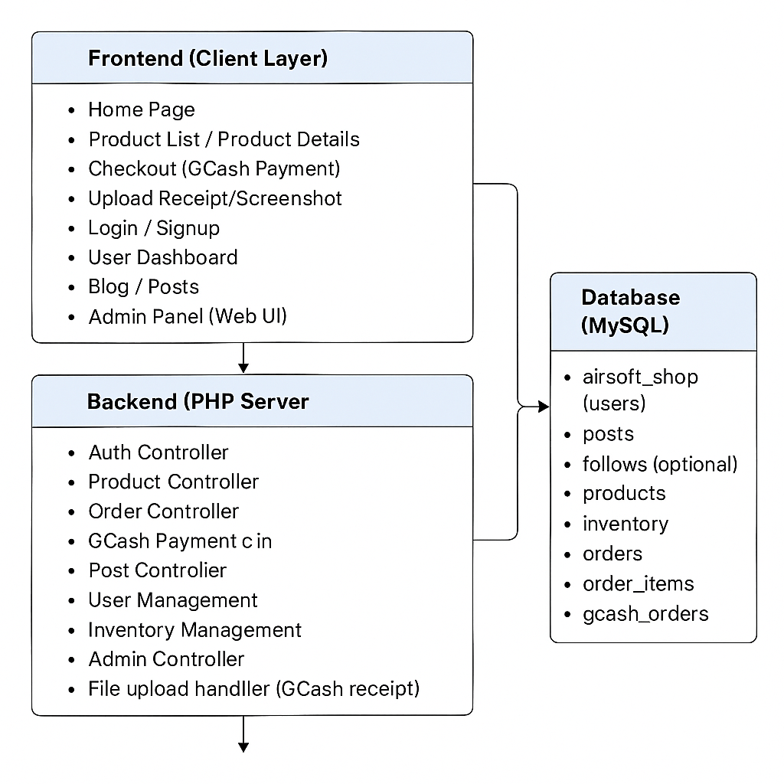
Systems Architecture

Slide 3
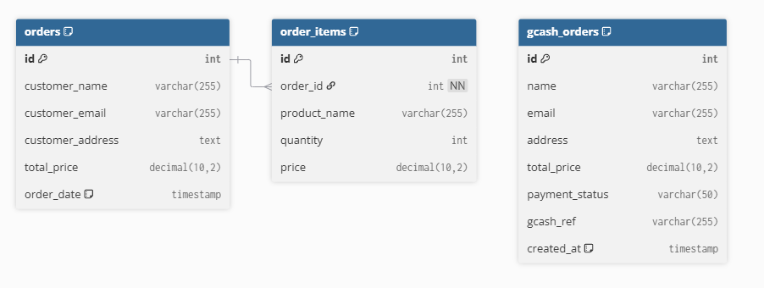
Database Design

Slide 4

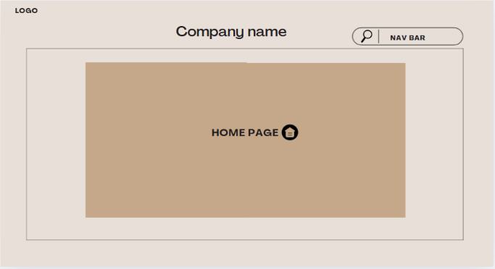
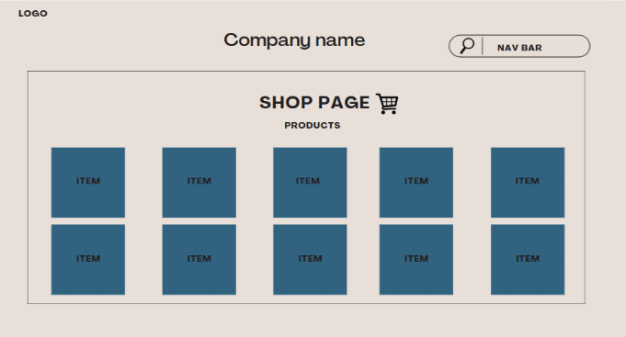
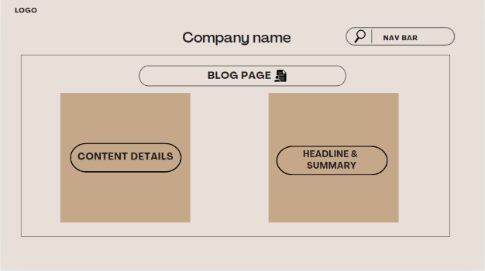
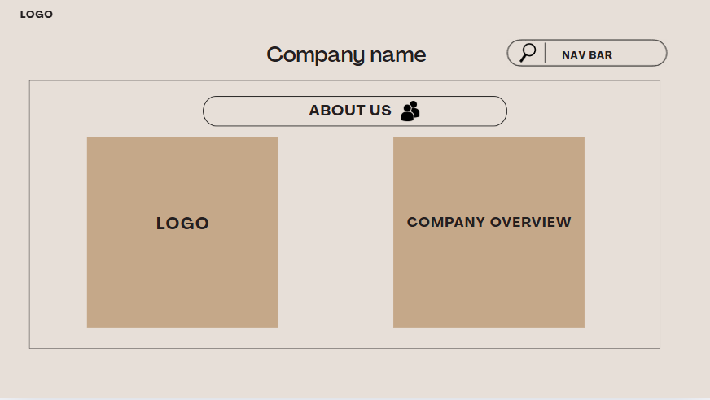
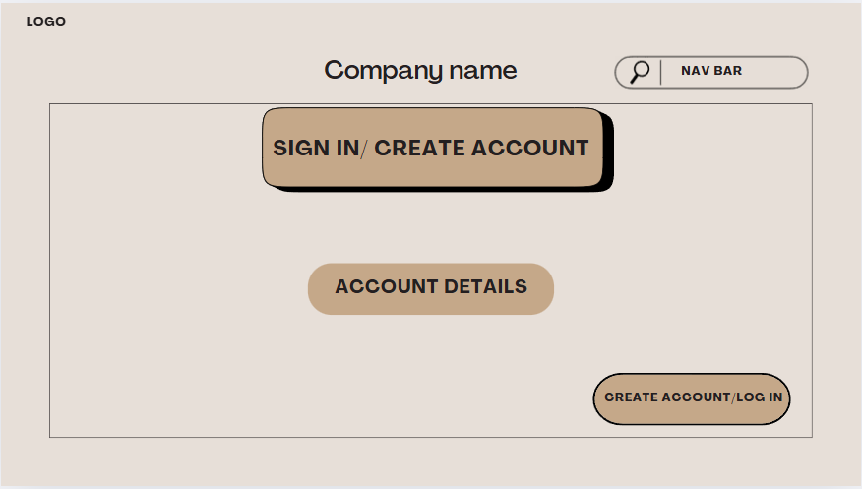
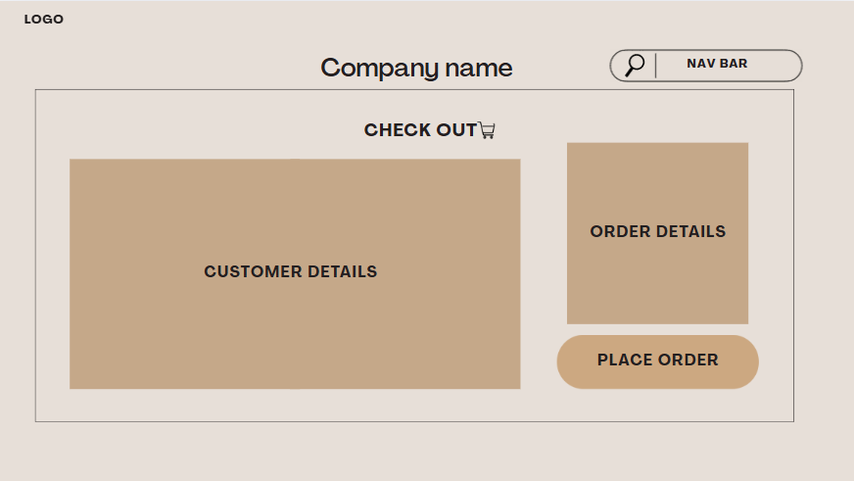
Home Page
Systems Storyboard
Shop page
Blog Page
About us page
Sign in/Create Account
Check out

Slide 5
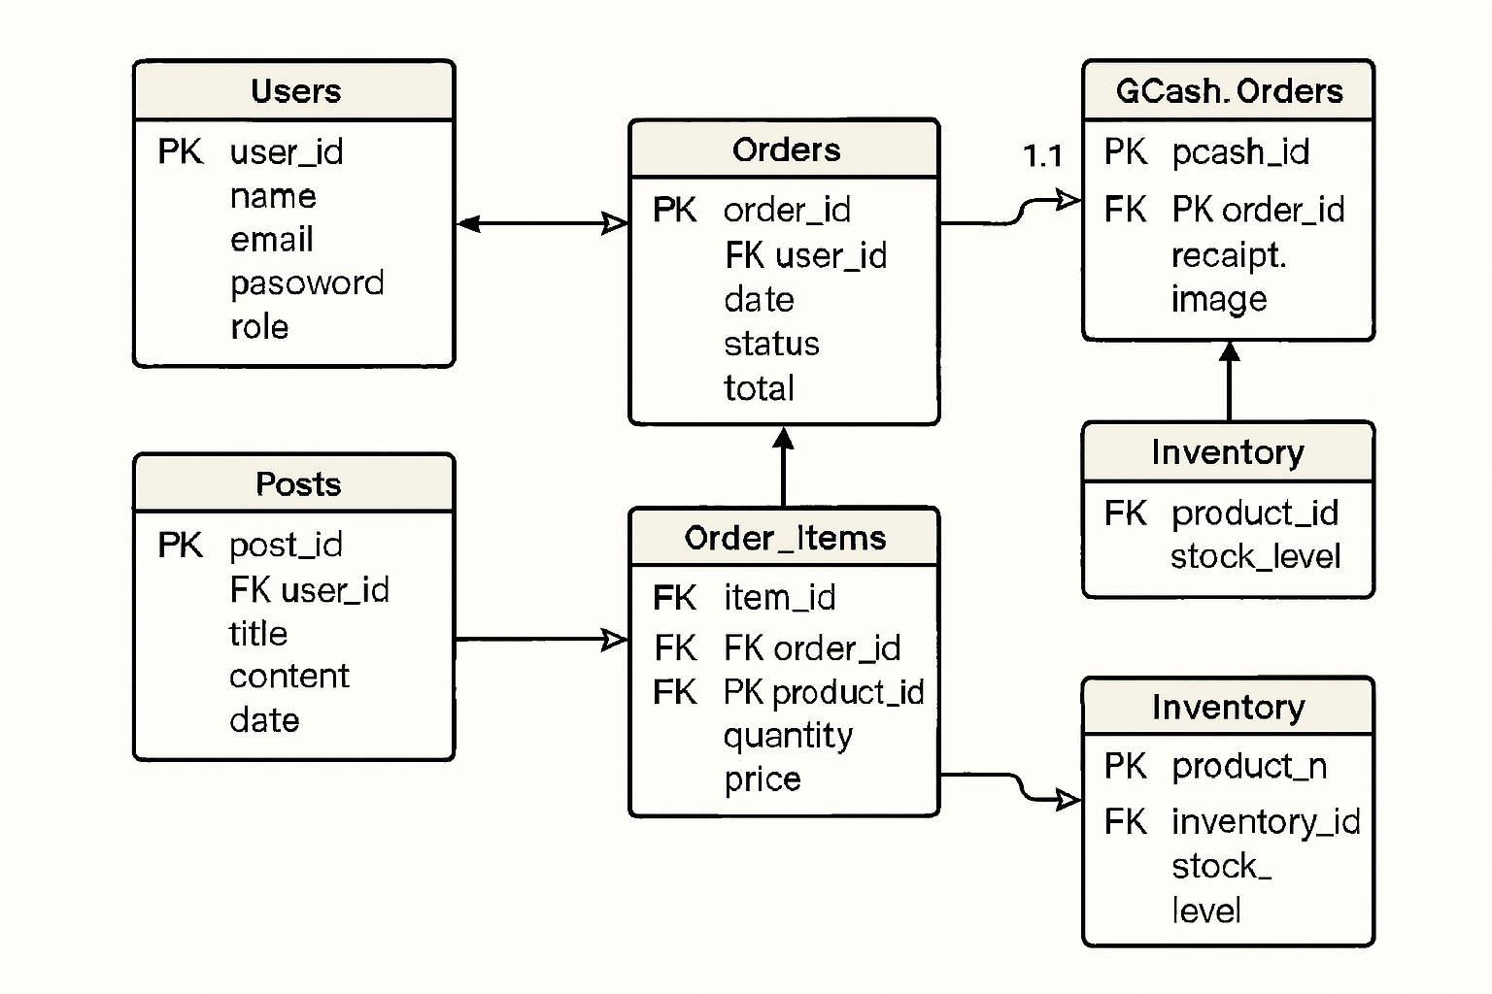
Systems Presentation

